Slide 1

Average causal effect estimation via instrumental variables: the no simultaneous heterogeneity assumption
Fernando Pires Hartwig^{1,2*}, George Davey Smith²,
Linbo Wang and Neil Martin Davies²
Online Causal Inference Seminar
Tuesday 12th April 2022
https://arxiv.org/pdf/2010.10017.pdf
¹Postgraduate Program in Epidemiology, Federal University of Pelotas, Pelotas, Brazil.
²MRC IEU, Bristol Medical School, University of Bristol, Bristol, United Kingdom.

Slide 2
Overview
Background and motivation
Identification
Mendelian randomization
Theory
Instrumental variable core assumptions
The 4th IV assumption
NEW: No Simultaneous Heterogeneity (NOSH)
NEW: Identification under a constant instrument-exposure association
Simulations
Empirical examples

Slide 3
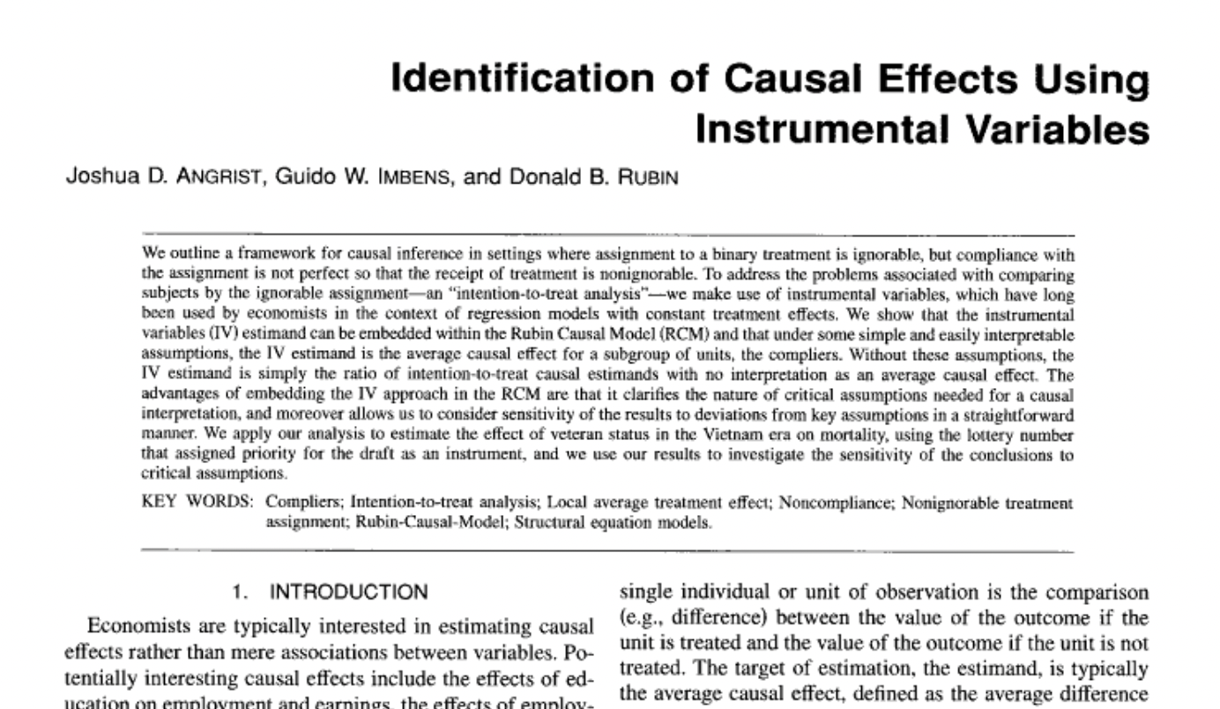
Background

Slide 4
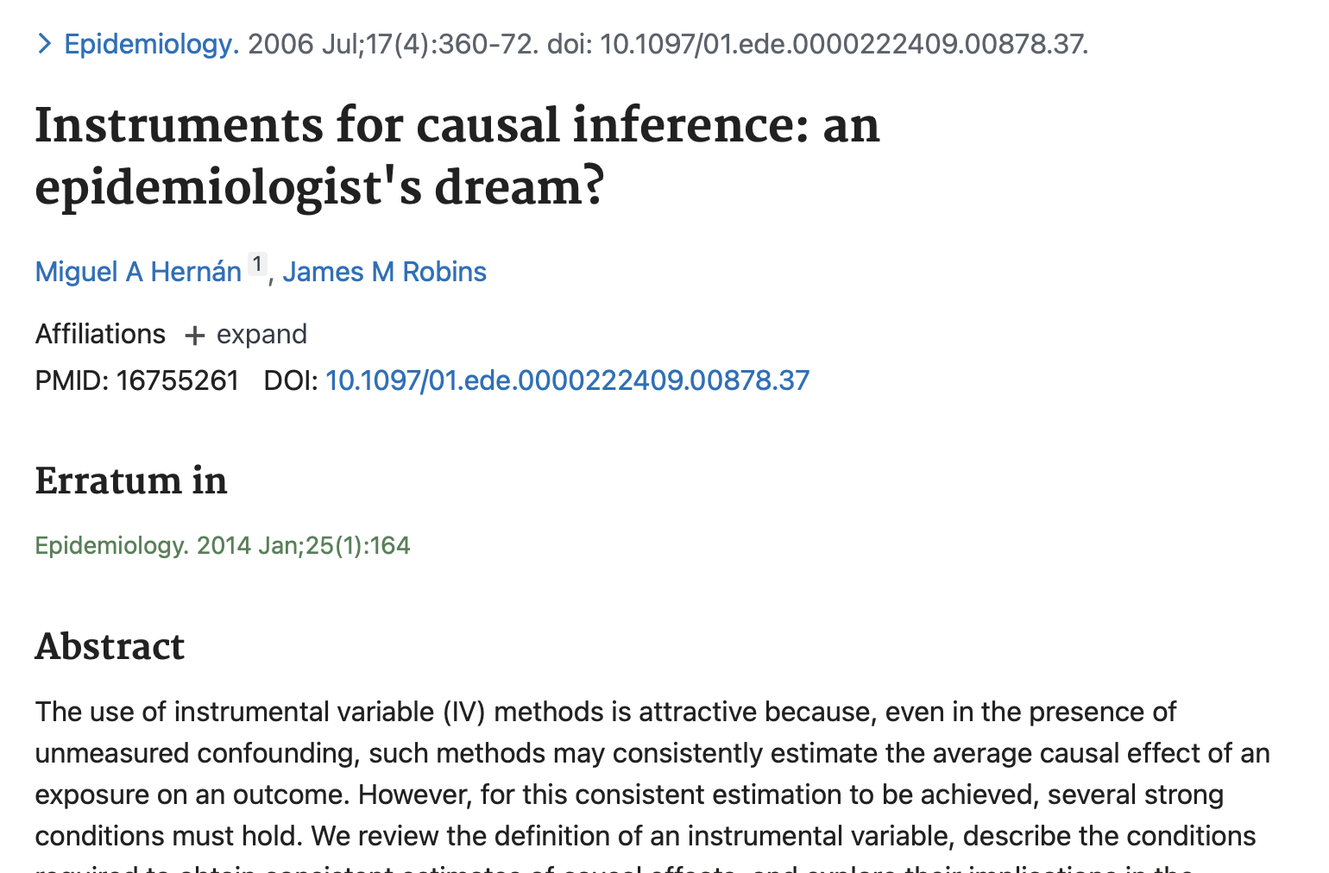

Slide 5
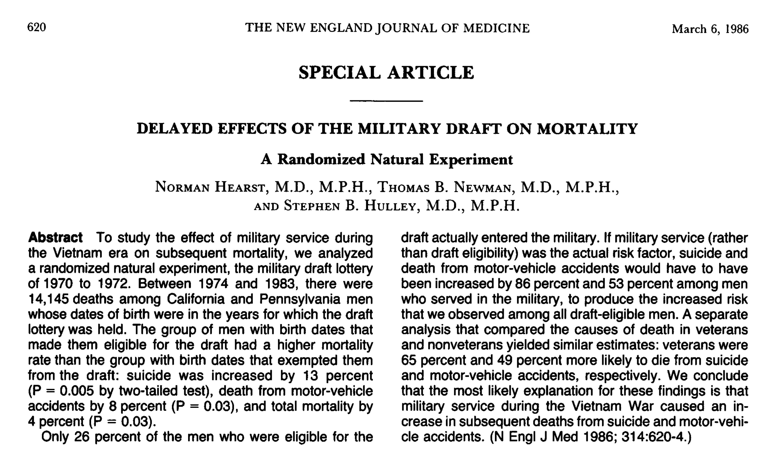

Slide 6


Slide 7
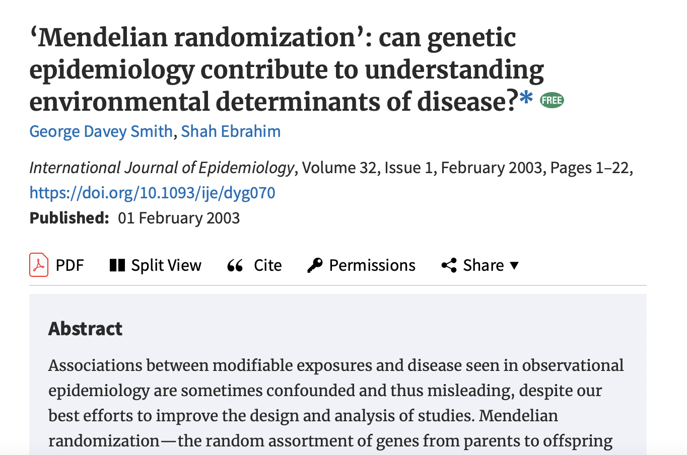
Mendelian randomization

Slide 8
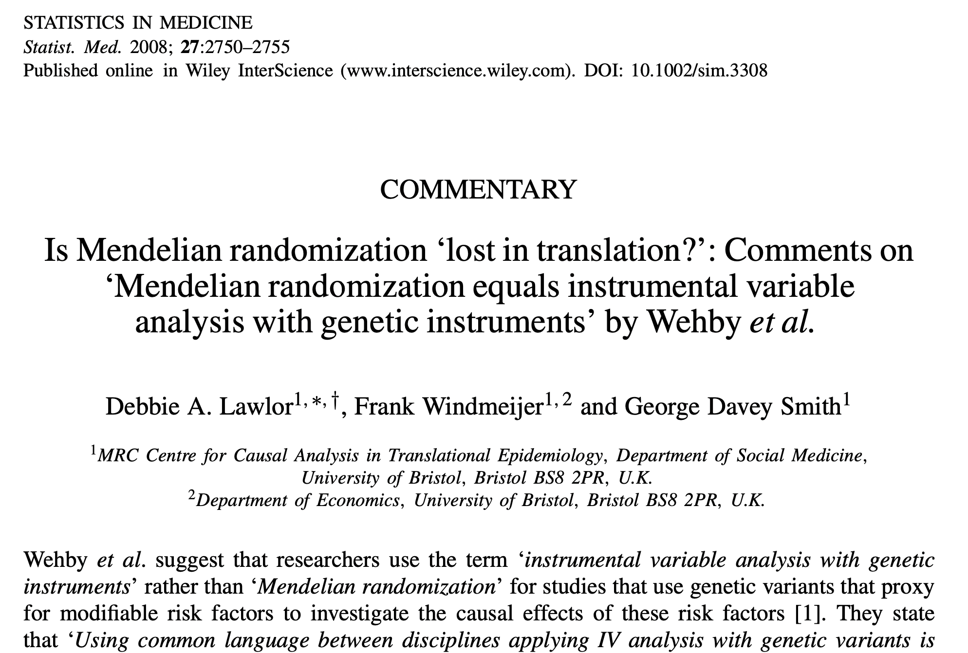
Mendelian randomization

Slide 9
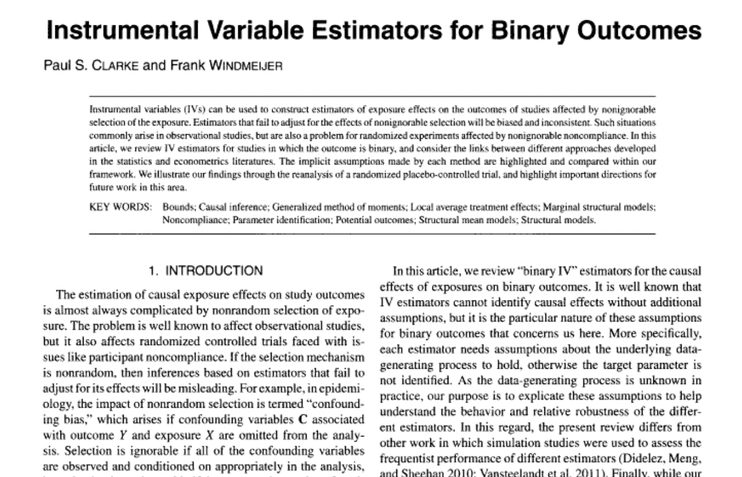

Slide 10
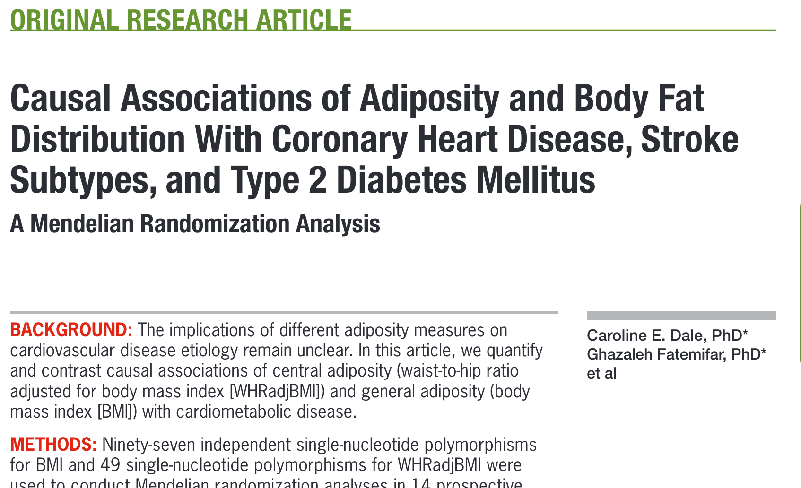
Motivation: MR and BMI and CHD
SNP-BMI association
r²=1.7%
Effect of BMI SNPs on CHD risk
?
IV/Wald estimate=
Odds-ratio=1.36 (95%CI: 1.22 to 1.52)
See Dale et al. 2017

Slide 11
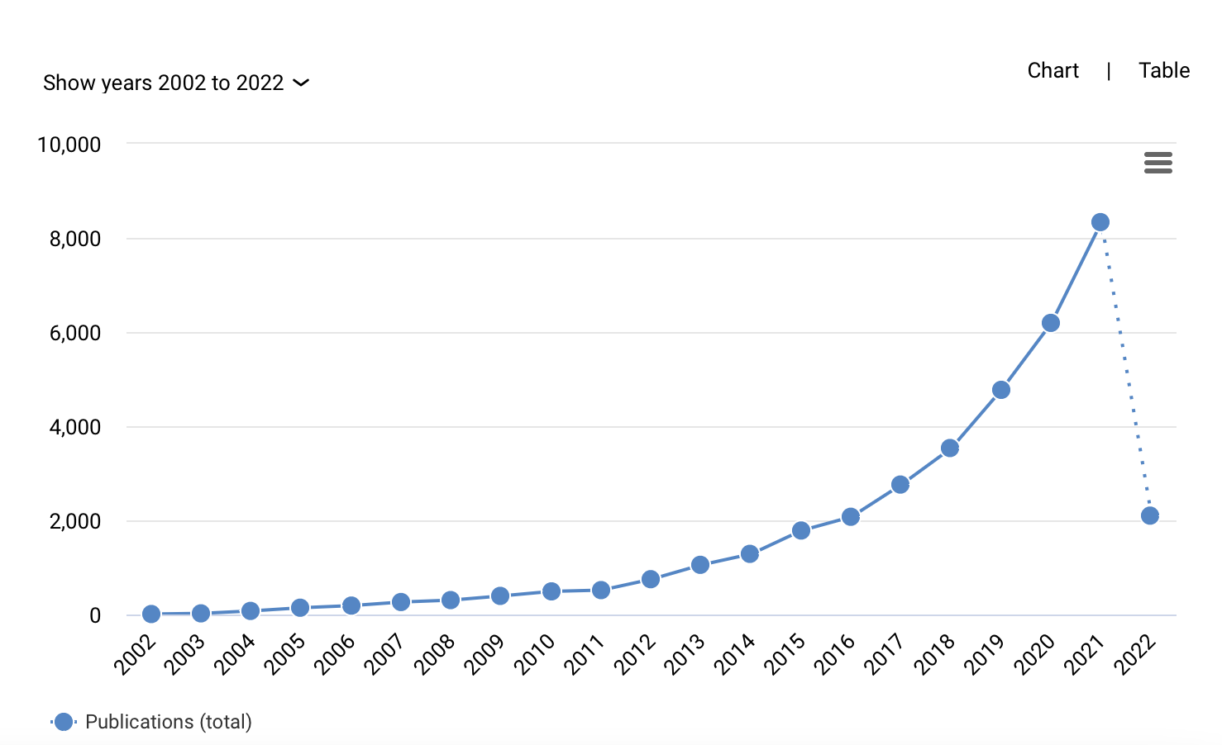
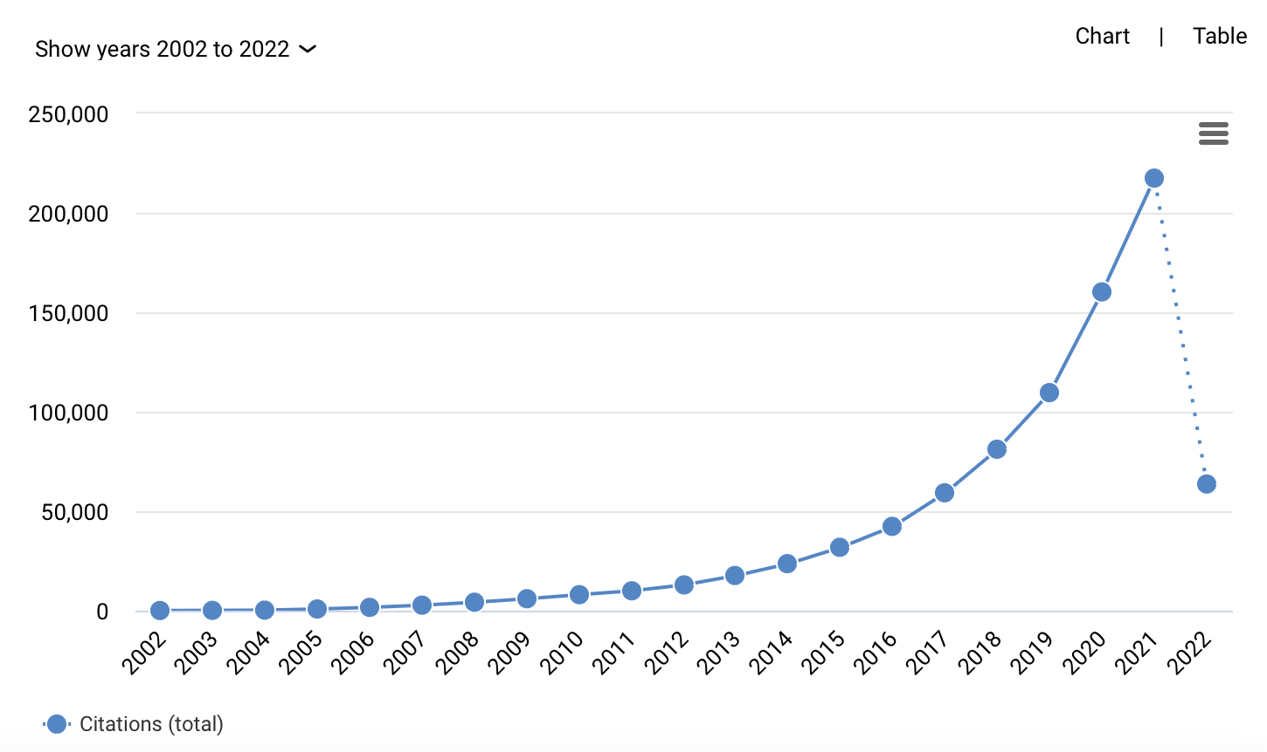
Mendelian randomization is quite widely used:
https://app.dimensions.ai search for “Mendelian randomization” OR “Mendelian randomisation"

Slide 12
Summary
Econometrics
Focused on trials or similar
E.g. draft lottery
Binary exposure and instrument
Assumed heterogenous treatment effects
Interpreted assuming monotonicity
Genetic epidemiology
Focused on genetics
Random inheritance of genetic variants at conception
Continuous exposure and instrument
Almost exclusively assumes constant treatment effects

Slide 13
2. Theory

Slide 14
Figure 1: Instrumental variable assumptions
Confounder
(U)
Instrumental variable
(Z)
Exposure
(X)
Outcome
(Y)
Are defined by three core assumptions:
Associate with the exposure (relevance)
Have no common cause with the outcome (independence)
Do not affect the outcome except via the exposure (exclusion)

Slide 15
Figure 2: Effect of BMI on Coronary Heart Disease
Confounder
(U)
BMI
SNPs
BMI
CHD
Are defined by three core assumptions:
Associate with the exposure (relevance) Yes
Have no common cause with the outcome (independence) Yes/maybe?
Do not affect the outcome except via the exposure (exclusion) Yes/maybe?
Dale et al. (2017)

Slide 16
The 4th instrumental variable assumptions
No 4th assumption (bounds)
Homogenous treatment effect
No effect modification
Instrument effect homogeneity
Monotonicity effect of the instrument on the exposure
No simultaneous heterogeneity (NOSH)

Slide 17
Identification with no 4th IV assumption
Instrumental variable bounds
Simple IV simulation (see GitHub for Stata code)
Core IV assumptions hold:
Z ∼ Bern(0.5)
U ∼ Bern(0.5)
pX = 0.05 + 0.1U, X ∼ Bern(pX)
p = 0.1 + 0.05X + 0.1U
Y ∼ Bern(p)
N=10,000

Slide 18
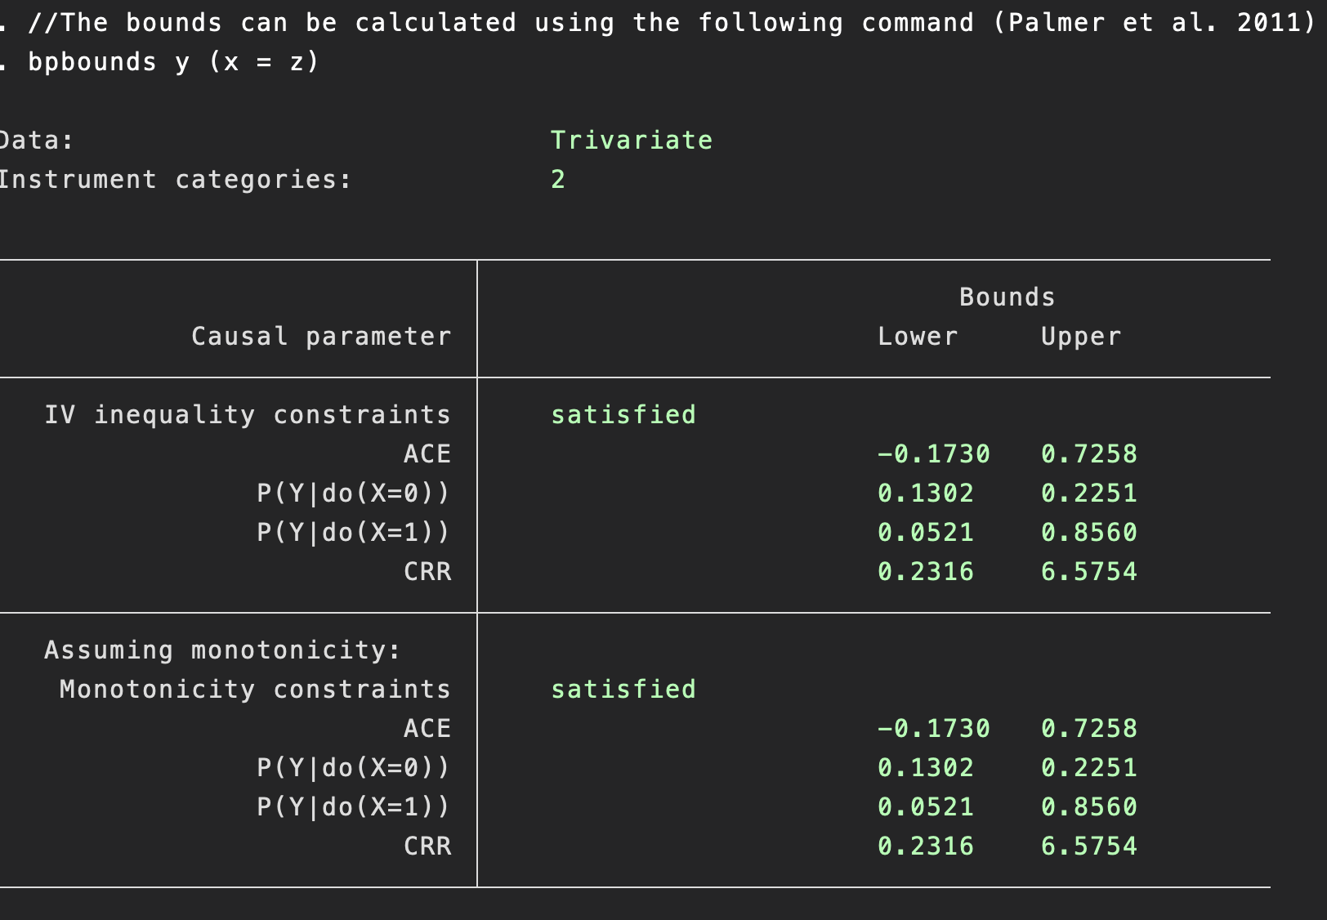
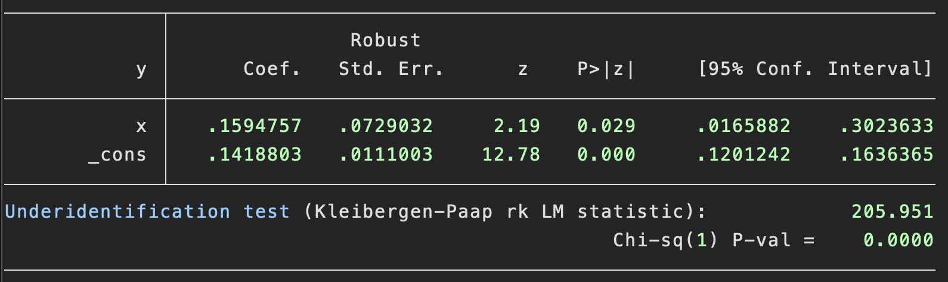
Balke-Pearl IV bounds
Balke-Pearl bounds:
Estimates largest and smallest values of the causal effect (ACE) consistent with the data
Note – these are not confidence intervals
A function of the mean values of the data (see Palmer et al. 2011) for derivation.
Two-stage least squares:
(N=10,000)

Slide 19
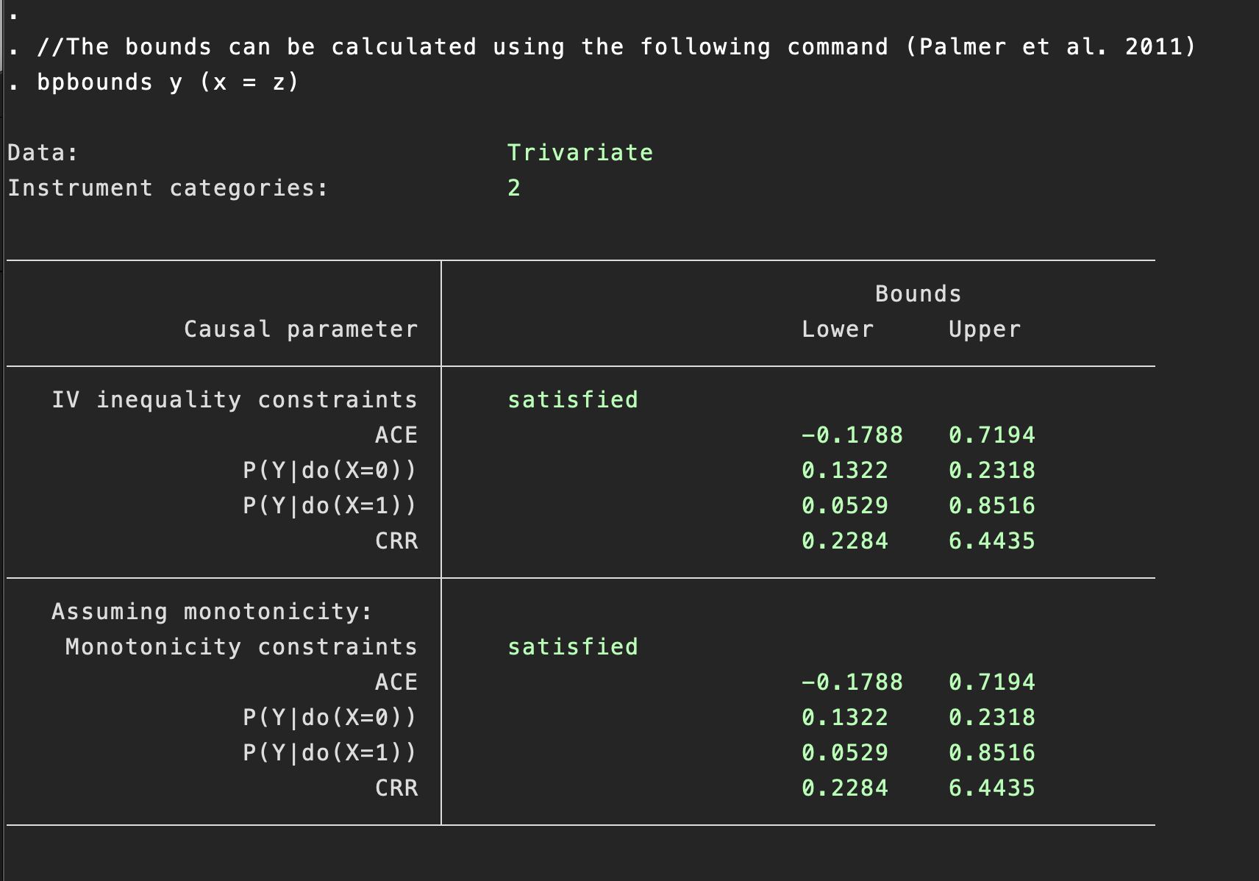
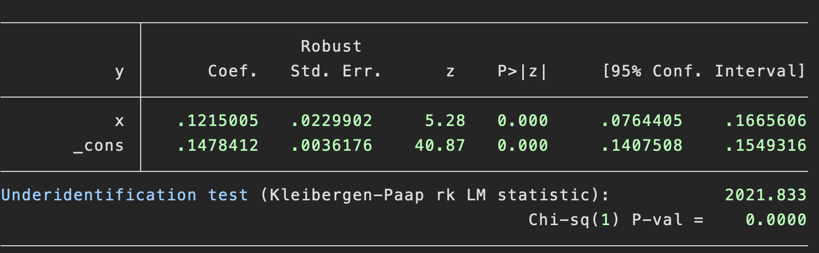
Balke-Pearl IV bounds
Balke-Pearl bounds:
Estimates largest and smallest values of the causal effect (ACE) consistent with the data
Note – these are not confidence intervals
A function of the mean values of the data (see Palmer et al. 2011) for derivation.
Two-stage least squares:
(N=100,000)

Slide 20
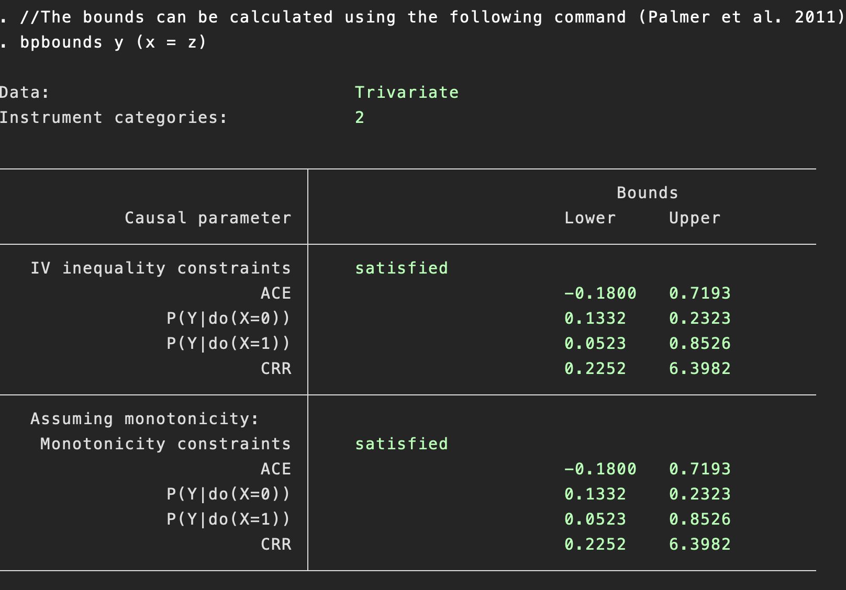
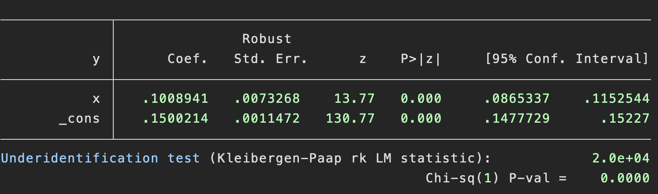
Balke-Pearl IV bounds
Balke-Pearl bounds:
Estimates largest and smallest values of the causal effect (ACE) consistent with the data
Note – these are not confidence intervals
A function of the mean values of the data (see Palmer et al. 2011) for derivation.
Unlike confidence intervals, IV bounds do not get more precise with more data
Two-stage least squares:
(N=1,000,000)

Slide 21
IV Bounds
Methodologically important
However, IV Bounds generally very imprecise
So practically not very useful
Can include in the supplement if a reviewer insists
Generally, we cannot identify the effect of an exposure solely using the 3 core IV assumptions.
Therefore, most IV analysis will make stronger “point identifying assumptions”

Slide 22

“Overall, our results suggest that while a bound-based analysis may be appealing due to its nonparametric nature, it is far more conservative in two-sample settings than in one-sample settings to get informative bounds on the causal exposure effect.”

Slide 23
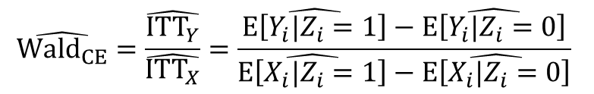
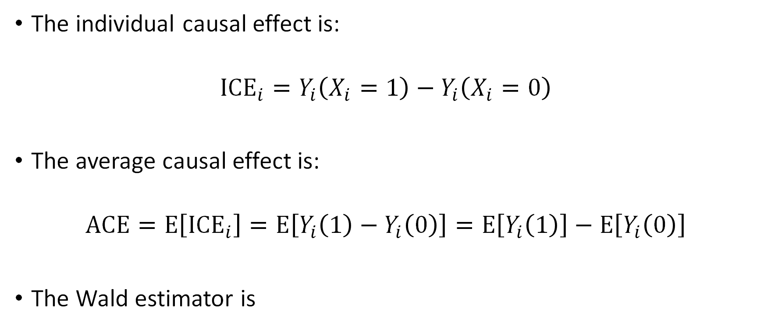
Some notation
The individual causal effect is:
$${ICE}_{i}=Y_{i}\left(X_{i}=1\right)−Y_{i}\left(X_{i}=0\right)$$
The average causal effect is:
$$ACE=E\left[{ICE}_{i}\right]=E\left[Y_{i}\left(1\right)−Y_{i}\left(0\right)\right]=E\left[Y_{i}\left(1\right)\right]−E\left[Y_{i}\left(0\right)\right]$$
The Wald estimator is
$$\hat{{Wald}_{CE}}=\frac{\hat{{ITT}_{Y}}}{\hat{{ITT}_{X}}}=\frac{\hat{E\left[Y_{i}|Z_{i}=1\right]}−\hat{E\left[Y_{i}|Z_{i}=0\right]}}{\hat{E\left[X_{i}|Z_{i}=1\right]}−\hat{E\left[X_{i}|Z_{i}=0\right]}}$$

Slide 24
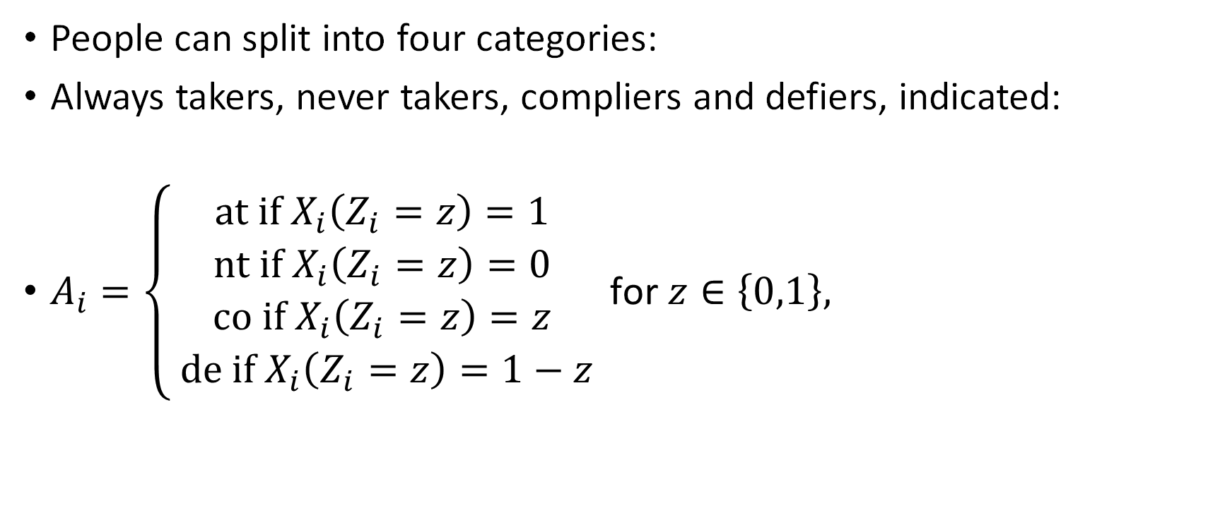
More notation: compliance type
People can split into four categories:
Always takers, never takers, compliers and defiers, indicated:
$A_{i}=\left\{\begin{matrix}at if X_{i}\left(Z_{i}=z\right)=1 \\ nt if X_{i}\left(Z_{i}=z\right)=0 \\ co if X_{i}\left(Z_{i}=z\right)=z \\ de if X_{i}\left(Z_{i}=z\right)=1−z\end{matrix}\right. \text{for} z∈\left\{0,1\right\},$

Slide 25
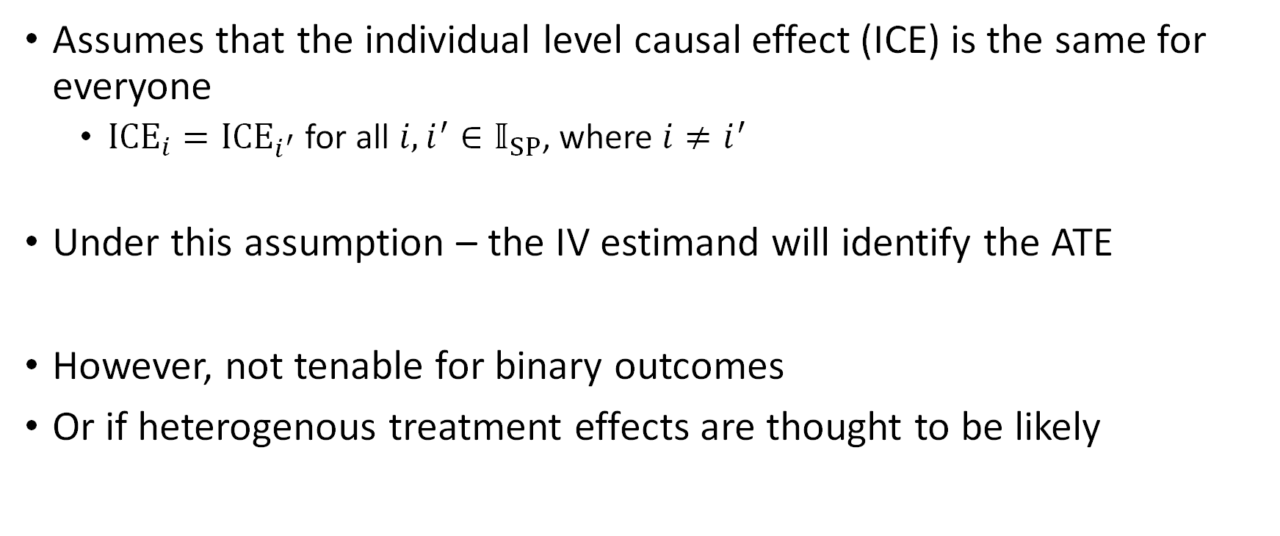
2. Homogenous treatment effects
Assumes that the individual level causal effect (ICE) is the same for everyone
${ICE}_{i}={ICE}_{i^{′}}$ for all $i,i^{′}∈𝕀_{SP}$, where $i≠i^{′}$
Under this assumption – the IV estimand will identify the ATE
However, not tenable for binary outcomes
Or if heterogenous treatment effects are thought to be likely

Slide 26
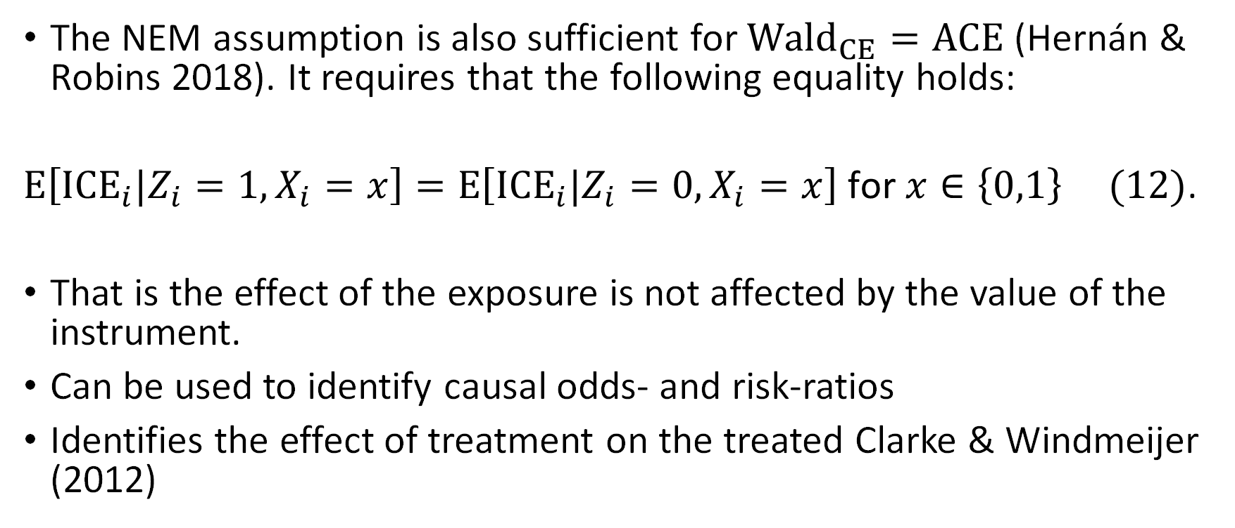
3. No effect modification
The NEM assumption is also sufficient for ${Wald}_{CE}=ACE$ (Hernán & Robins 2018). It requires that the following equality holds:
$E\left[{ICE}_{i}|Z_{i}=1,X_{i}=x\right]=E\left[{ICE}_{i}|Z_{i}=0,X_{i}=x\right]$ $\text{for} x∈\left\{0,1\right\} (12)$.
That is the effect of the exposure is not affected by the value of the instrument.
Can be used to identify causal odds- and risk-ratios
Identifies the effect of treatment on the treated Clarke & Windmeijer (2012)

Slide 27
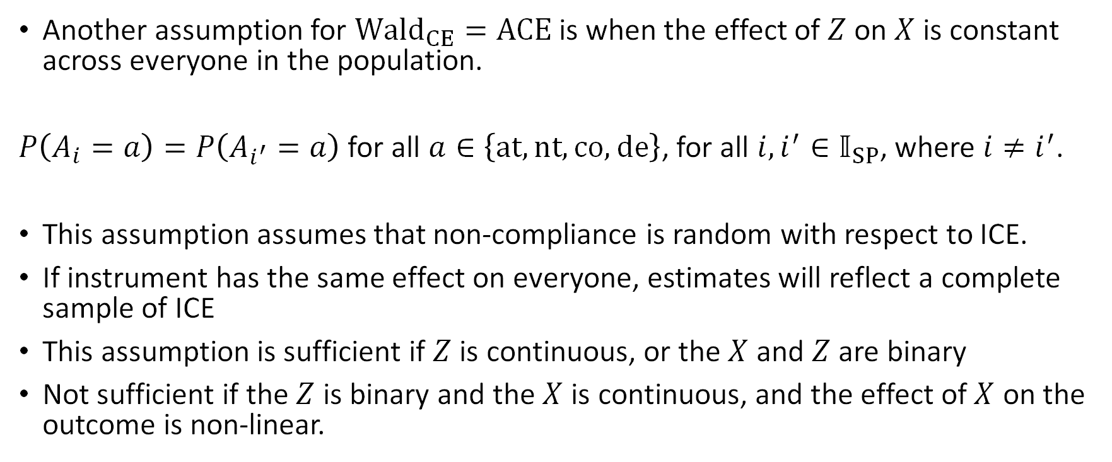
4. Instrument effect homogeneity
Another assumption for ${Wald}_{CE}=ACE$ is when the effect of $Z$ on $X$ is constant across everyone in the population.
$P\left(A_{i}=a\right)=P\left(A_{i^{′}}=a\right)$ for all $a∈\left\{at,nt,co,de\right\}$, for all $i,i^{′}∈𝕀_{SP}$, where $i≠i^{′}$.
This assumption assumes that non-compliance is random with respect to ICE.
If instrument has the same effect on everyone, estimates will reflect a complete sample of ICE
This assumption is sufficient if $Z$ is continuous, or the $X$ and $Z$are binary
Not sufficient if the $Z$ is binary and the $X$ is continuous, and the effect of $X$ on the outcome is non-linear.

Slide 28
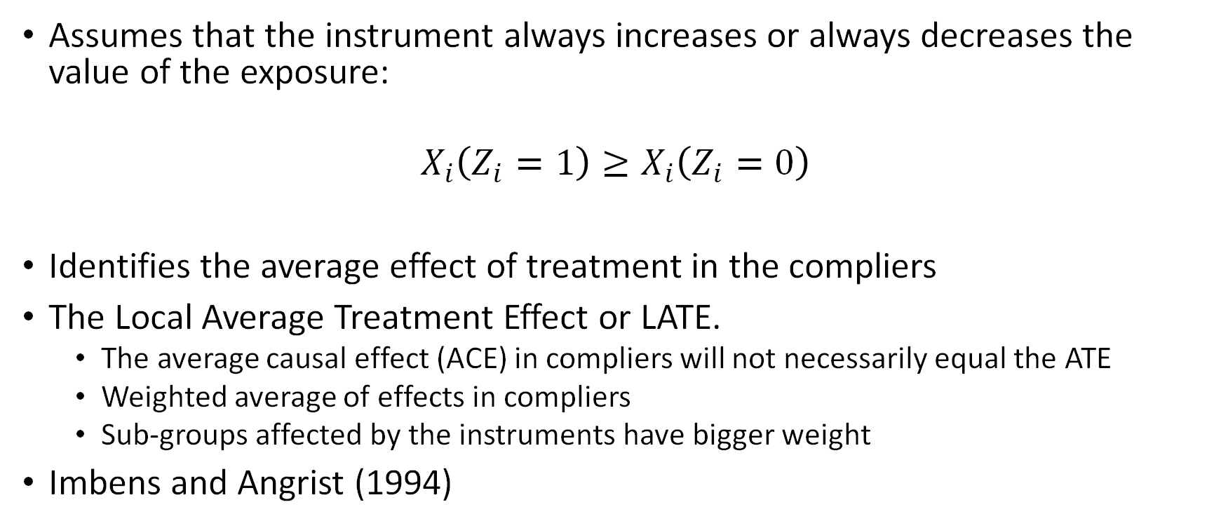
5. Monotonicity
Assumes that the instrument always increases or always decreases the value of the exposure:
$$X_{i}\left(Z_{i}=1\right)≥X_{i}\left(Z_{i}=0\right)$$
Identifies the average effect of treatment in the compliers
The Local Average Treatment Effect or LATE.
The average causal effect (ACE) in compliers will not necessarily equal the ATE
Weighted average of effects in compliers
Sub-groups affected by the instruments have bigger weight
Imbens and Angrist (1994)

Slide 29
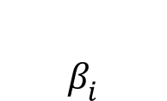
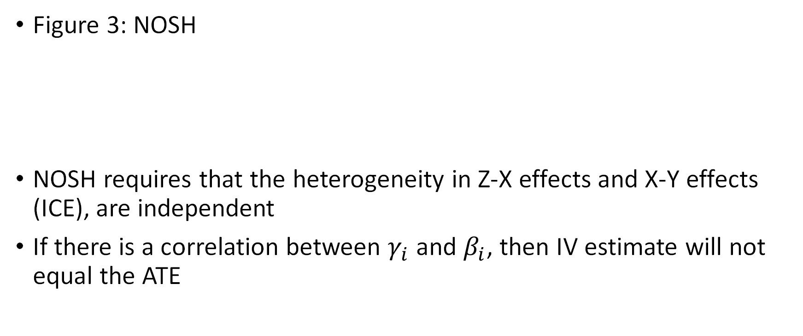

6. NOSH – no simultaneous heterogeneity
Confounder
(U)
Figure 3: NOSH
NOSH requires that the heterogeneity in Z-X effects and X-Y effects (ICE), are independent
If there is a correlation between $γ_{i}$ and $β_{i}$, then IV estimate will not equal the ATE
$$γ_{i}$$
$$β_{i}$$
Instrument
Exposure
Outcome

Slide 30
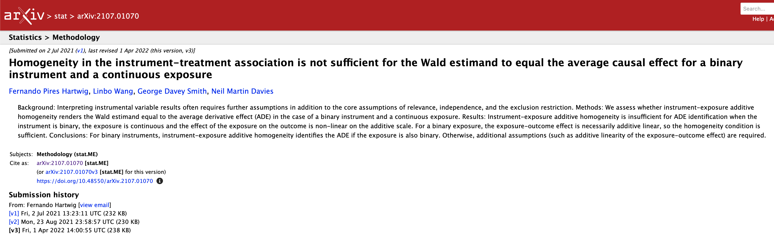

Slide 31
Point identifying assumptions: the fourth IV assumption
Assumption | Target parameter | Relevant population | Notes
1. Constant effect of the exposure | Average treatment effect | Whole population | Implausible for binary outcomes.
2. No effect modification | Average effect of treatment in the treated | Those who are treated
3. Monotonicity | Local average treatment effect | People who exposure was affected by the instrument | Unidentified sub-group
4. No simultaneous heterogeneity (NOSH) | Average treatment effect | Whole population | Validity depends on the correlation between the effects
Other 4th IV assumptions are available…

Slide 32
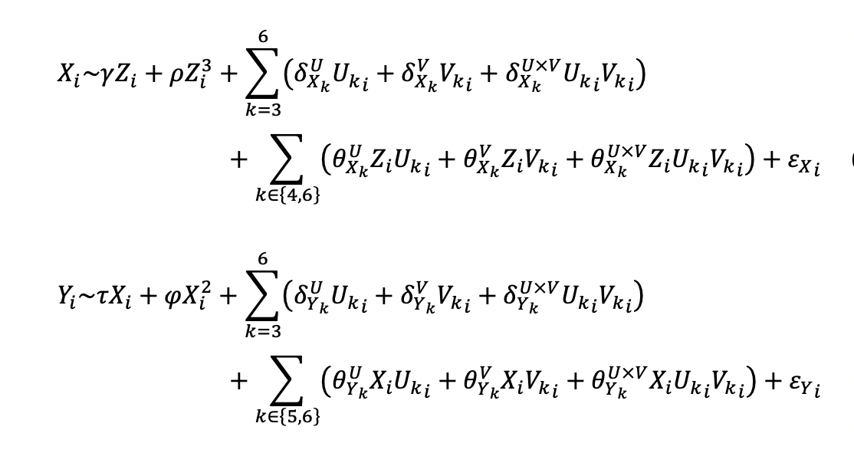
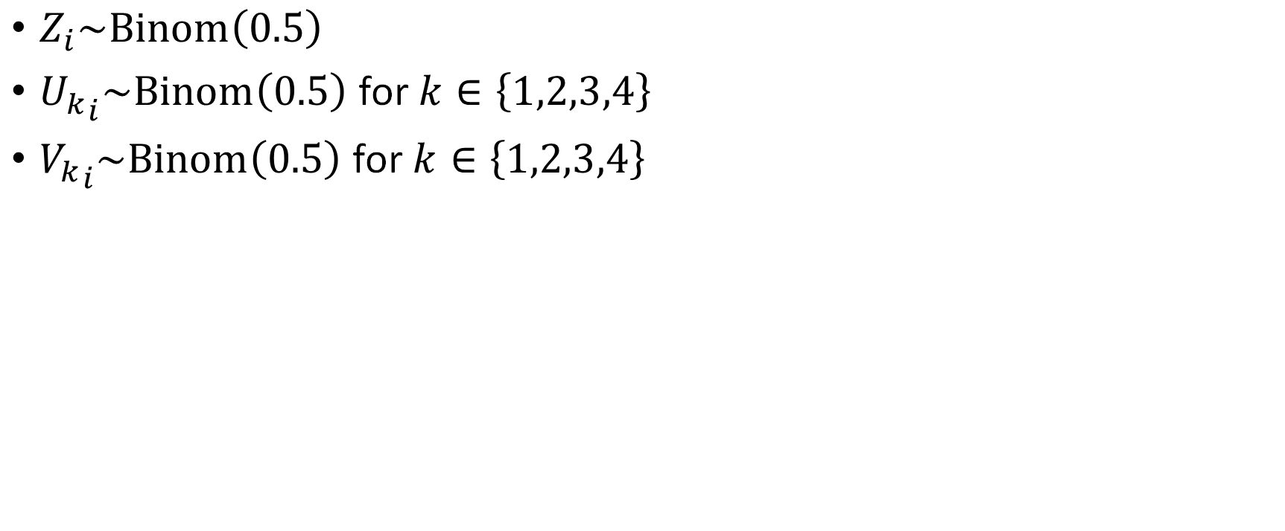
Illustrative simulation
$Z_{i}\sim Binom\left(0.5\right)$
${U_{k}}_{i}\sim Binom\left(0.5\right)$for $k∈\left\{1,2,3,4\right\}$
${V_{k}}_{i}\sim Binom\left(0.5\right)$for $k∈\left\{1,2,3,4\right\}$

Slide 33
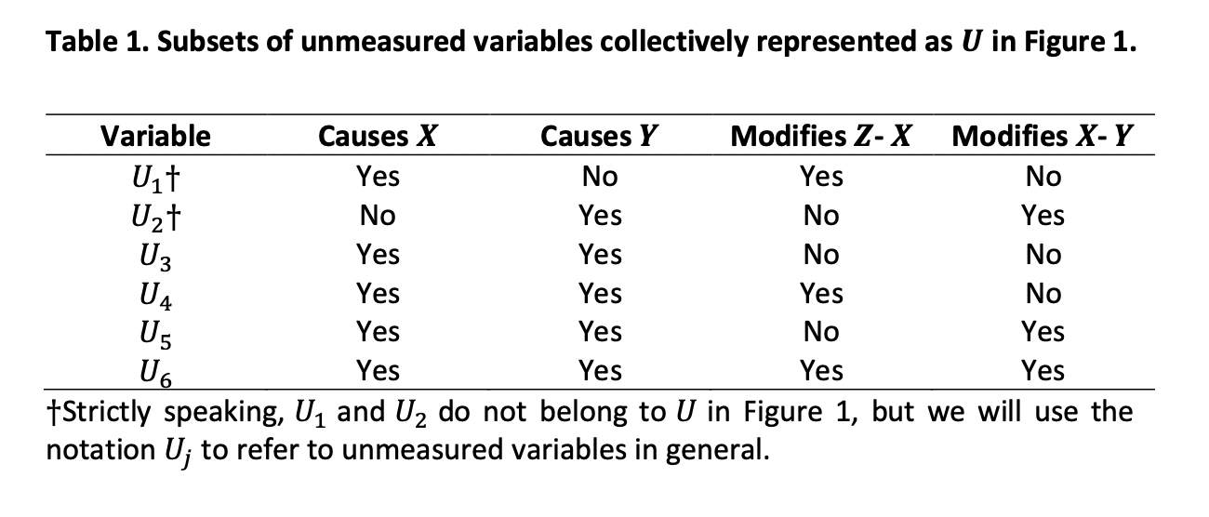

Slide 34
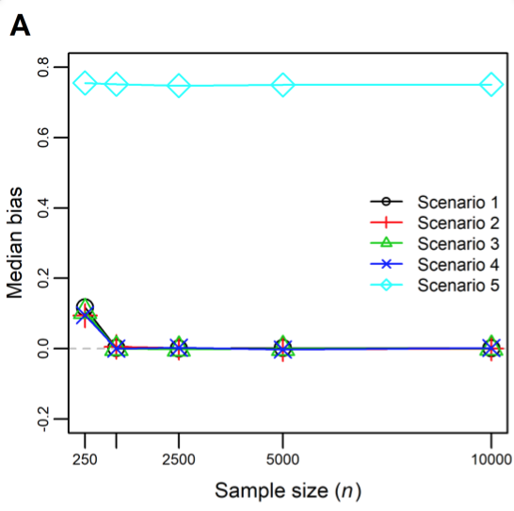
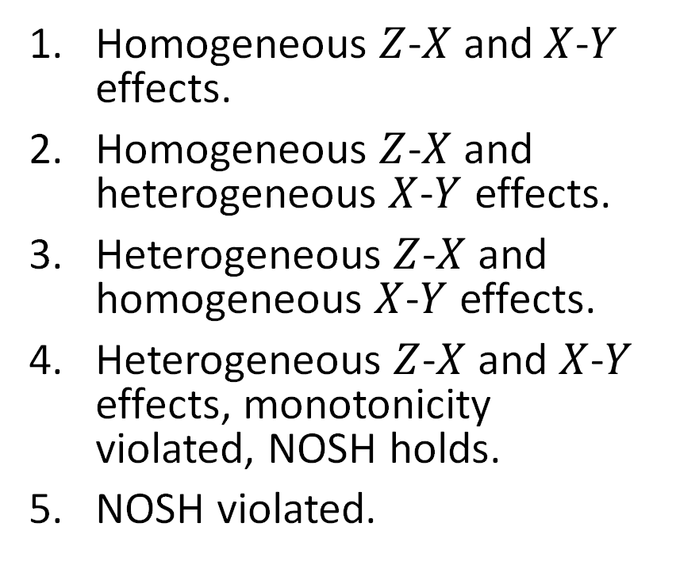
Figure 4: Median bias of two-stage least squares as an estimator of the ACE
Homogeneous $Z$-$X$ and $X$-$Y$ effects.
Homogeneous $Z$-$X$ and heterogeneous $X$-$Y$ effects.
Heterogeneous $Z$-$X$ and homogeneous $X$-$Y$ effects.
Heterogeneous $Z$-$X$ and $X$-$Y$ effects, monotonicity violated, NOSH holds.
NOSH violated.

Slide 35
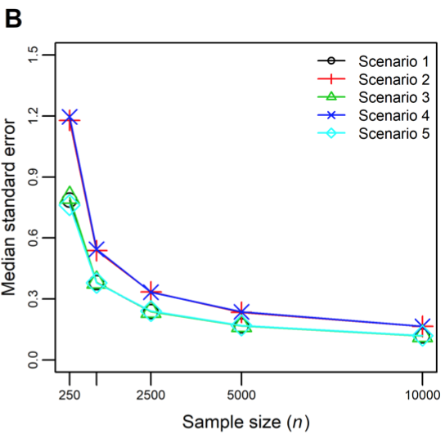
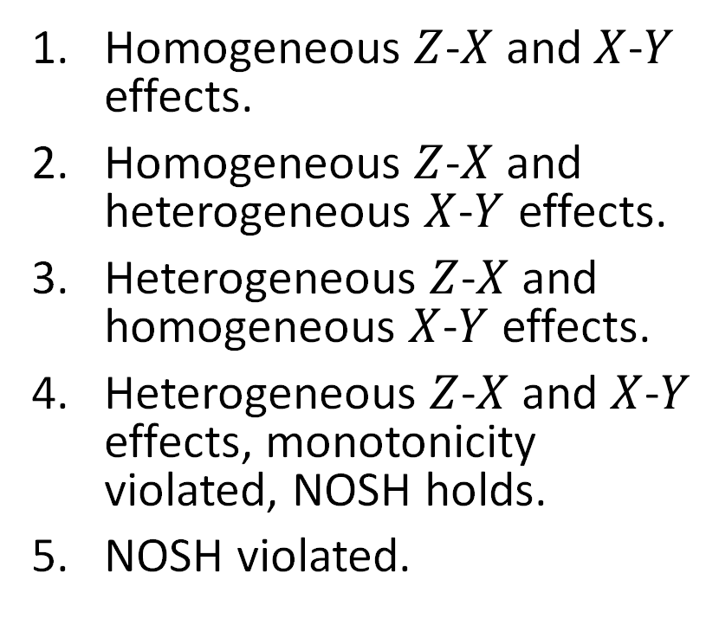
Figure 5: Median standard error of two-stage least squares as an estimator of the ACE
Homogeneous $Z$-$X$ and $X$-$Y$ effects.
Homogeneous $Z$-$X$ and heterogeneous $X$-$Y$ effects.
Heterogeneous $Z$-$X$ and homogeneous $X$-$Y$ effects.
Heterogeneous $Z$-$X$ and $X$-$Y$ effects, monotonicity violated, NOSH holds.
NOSH violated.

Slide 36
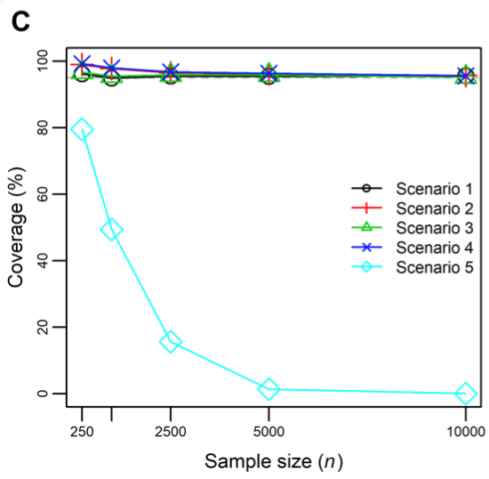
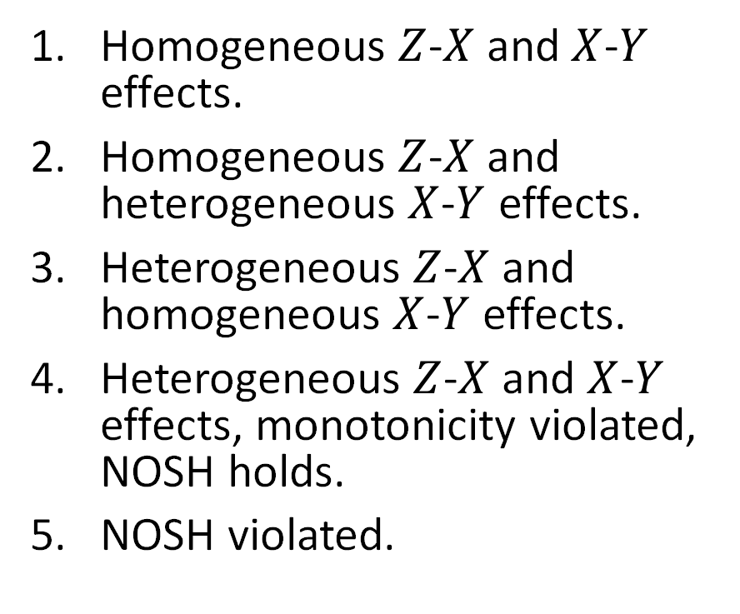
Figure 6: Coverage of two-stage least squares as an estimator of the ACE
Homogeneous $Z$-$X$ and $X$-$Y$ effects.
Homogeneous $Z$-$X$ and heterogeneous $X$-$Y$ effects.
Heterogeneous $Z$-$X$ and homogeneous $X$-$Y$ effects.
Heterogeneous $Z$-$X$ and $X$-$Y$ effects, monotonicity violated, NOSH holds.
NOSH violated.

Slide 37
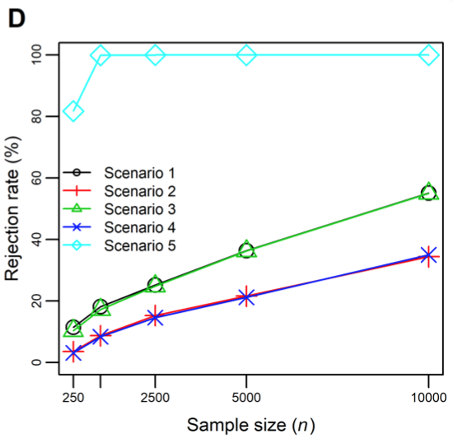
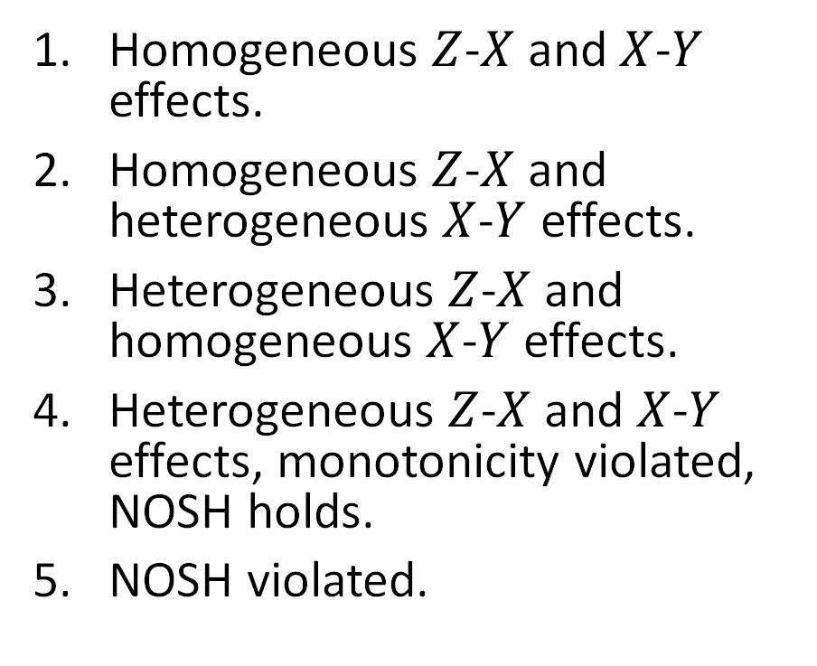
Figure 7: Rejection rate of two-stage least squares as an estimator of the ACE
Homogeneous $Z$-$X$ and $X$-$Y$ effects.
Homogeneous $Z$-$X$ and heterogeneous $X$-$Y$ effects.
Heterogeneous $Z$-$X$ and homogeneous $X$-$Y$ effects.
Heterogeneous $Z$-$X$ and $X$-$Y$ effects, monotonicity violated, NOSH holds.
NOSH violated.

Slide 38
Summary of simulations
IV estimate can equal ATE even if Homogeneity, NEM, monotonicity do not hold
If effect heterogeneity is independent then can still be unbiased
Bias requires violation of NOSH
How plausible NOSH?

Slide 39
Figure 8 Mendelian randomization: the effect of BMI on coronary heart disease (Dale et al. (2017)
FTO
MC4R
…
…
BMI SNP₉₇
Confounder
(U)
BMI
Under a constant treatment effect:
Identifies the average effect of BMI on CHD
Under monotonicity
Identifies a weighted local average treatment effect – gives greater weight to SNPs with bigger effects
Interpretation of estimates of effects of continuous exposures under monotonicity unclear
NOSH:
Heterogeneity in effect of instrument? Maybe (e.g. FTO)
Heterogeneity in effect of treatment? Yes (binary outcome/probably)
Is NOSH plausible? Maybe
Is the heterogeneity in effect of SNPs on BMI and the effect of BMI on CHD likely to be dependent?
CHD

Slide 40
Summary
NOSH requires independence of the:
Instrument-exposure heterogeneity
Exposure-outcome heterogeneity
NOSH identifies the average effect of treatment (ATE) even if constant treatment effect, NEM, and monotonicity are violated
Homogeneous treatment effects and NEM assumptions are special cases of NOSH
Monotonicity does not identify an ATE is not directly comparable to NOSH
Untestable

Slide 41
Thanks for listening!
Acknowledgements
Co-authors
Fernando Hartwig in particular
George Davey Smith, Linbo Wang
Funders
The MRC and the University of Bristol support the MRC Integrative Epidemiology Unit [MC_UU_00011/1].
This work was supported by the ESRC via a Future Research Leaders grant [ES/N000757/1].

Slide 42
References
Swanson, S. A., Hernán, M. A., Miller, M., Robins, J. M. & Richardson, T. S. Partial Identification of the Average Treatment Effect Using Instrumental Variables: Review of Methods for Binary Instruments, Treatments, and Outcomes. Journal of the American Statistical Association 113, 933–947 (2018).
Swanson, S. A. Can we see the forest for the IVs? Mendelian Randomization studies with multiple genetic variants. Epidemiology (2016). doi:10.1097/EDE.0000000000000558
Balke, A. & Pearl, J. Bounds on Treatment Effects from Studies with Imperfect Compliance. Journal of the American Statistical Association 92, 1171–1176 (1997).
Palmer, T. M., Ramsahai, R. R., Didelez, V. & Sheehan, N. A. Nonparametric bounds for the causal effect in a binary instrumental-variable model. Stata Journal 11, 345–367 (2011).
Sommer, A. et al. Impact of vitamin A supplementation on childhood mortality. A randomised controlled community trial. Lancet 1, 1169–1173 (1986).
Greenland, S. An introduction to instrumental variables for epidemiologists. Int J Epidemiol 29, 722–729 (2000).
Angrist, J. D. Lifetime earnings and the Vietnam era draft lottery: evidence from social security administrative records. The American Economic Review 313–336 (1990).
Dale, C. E. et al. Causal Associations of Adiposity and Body Fat Distribution With Coronary Heart Disease, Stroke Subtypes, and Type 2 Diabetes Mellitus: A Mendelian Randomization Analysis. Circulation 135, 2373–2388 (2017).
Hernán, M. & Robins, J. Causal Inference. (Boca Raton: Chapman & Hall/CRC, forthcoming., 2018).
Clarke, P. S. & Windmeijer, F. Instrumental Variable Estimators for Binary Outcomes. Journal of the American Statistical Association 107, 1638–1652 (2012).
Imbens, G. W. & Angrist, J. D. Identification and Estimation of Local Average Treatment Effects. Econometrica 62, 467 (1994).
Linbo Wang and Eric Tchetgen Tchetgen (2017+). Bounded, Efficient and Multiply Robust Estimation of Average Treatment Effects Using Instrumental Variables. Journal of the Royal Statistical Society: Series B, to appear.

